Slide 1



Data Wars- Case Study
| Ranit Oberai |
SCMHRD, Pune

Slide 2
Complete Dataset in Numbers
33
Independent Variables
02
Years
3080
Test Data
2129
Number of missing rows
34
Outliers
03
Categorical Variables
4536
Number of missing vales
3198
Train Data

Slide 3
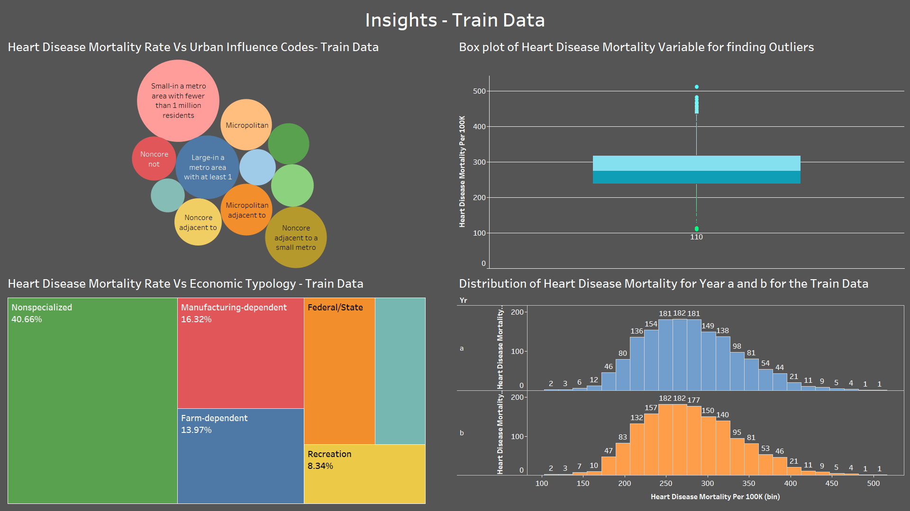

Slide 4




Some Important Insights
RURAL URBAN CODES
20.49 %
Urban Influence Codes
Heart Disease mortality rate is highest for “Nonmetro - Urban population of 2,500 to 19,999, adjacent to a metro area” category
21.03 %
Heart Disease mortality rate is highest for “Small-in a metro area with fewer than 1 million residents” category
40.66 %
99.99 %
Year
County
Typology Codes
Heart disease mortality rate exhibits almost same pattern in both the years
Heart Disease mortality rate is highest for “Nonspecialized” category

Slide 5
Steps Followed in Model Making
Predict health_pct_excessive_drinking, it has 30.58% of missing data
Train Model on training dataset
Choose the best Model
Remove health_homicides_per_100k since it has 61.50% of Missing values
Impute using Mice library for all the other missing values
See Adjusted
R-square and RMSE
Predict on the Test data

Slide 6
Model Journey with their respective Adjusted R- Square Values
79.70 %
74.79 %
73.29 %
68.62 %
58.26 %
XGB Linear Model
XGB-Tree Model
Cubist Model
Factor Analysis followed by Multiple Linear Regression
Multiple Linear Regression

Slide 7
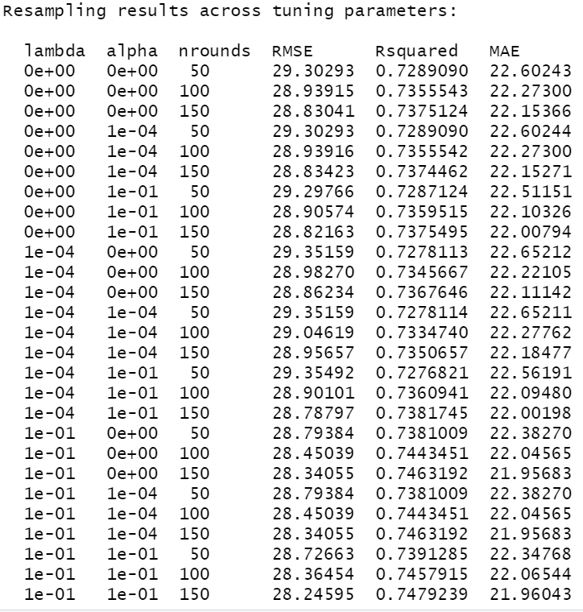
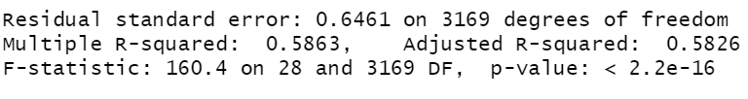
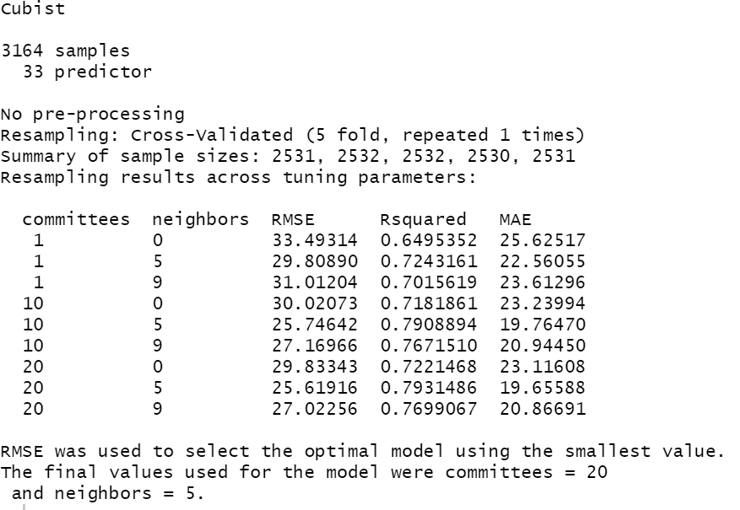
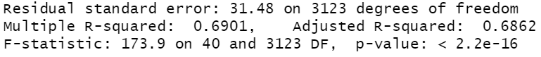
Output of Models
XGB -Linear
Factor Analysis
Cubist Model
Linear Regression

Slide 8
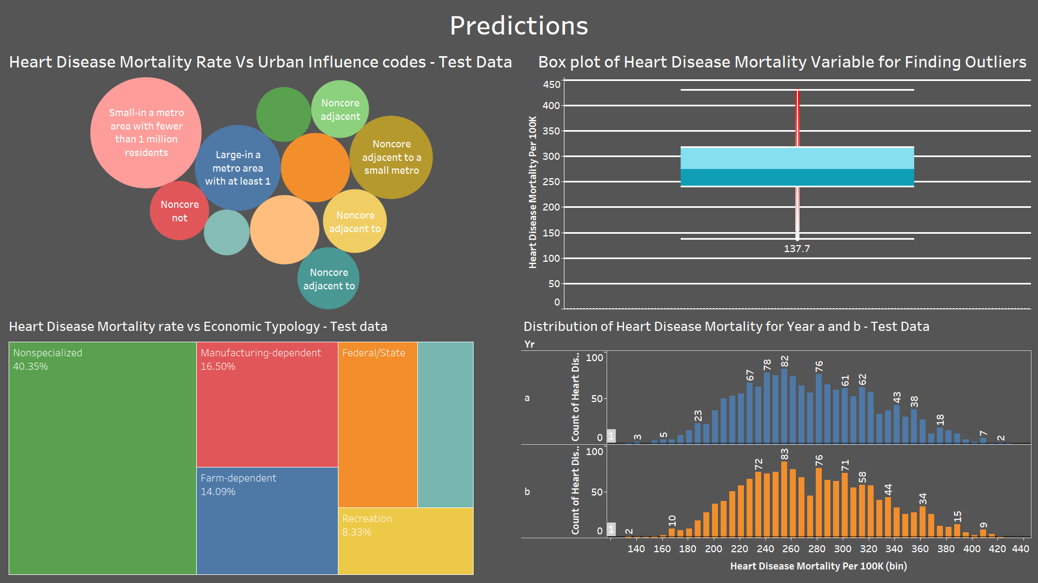

Slide 9
Predictions in Numbers
04
03
02
01
Economic Typology
Urban Influence
Rural-Urban Continuum Codes
Year
40.35% of Heart disease Mortality rate will occur in Non specialized Economic Typology
21.97% of Heart disease mortality rate will occur in small metro with fewer than 1M residents
20.44% of Heart disease mortality rate will occur in Non metro urban population of 2500 to 1999, adjacent to metro area
Pattern will be same for 2 years

Slide 10



Appendix
Programming language used
Code and output files
Graphical representation tools

Slide 11

Thank You!
Notes:
Picture : https://unsplash.com/

